Slide 1


Economics
ICT SEM 4
Group 6

Slide 2
Group members
Maunil Vyas 1401007
Deep Patel 1401010
Shreyas Patel 1401025
Jay Dangar 1401043
Pratham Solanki 1401049
Ashutosh Kakadiya 1401075
Deep Talati 1401085
Harsh Mehta 1401086
Kishan Raval 1401117

Slide 3
Significance of Onion in India’s Economy
Onion ranks third in the world production of major vegetables.
In India, however, it's significance is defined not only by its essential role in the diets of millions of Indians, rich and poor, but also the resulting political significance.
Onion is the only vegetable that can bring down a government from power. As history has shown, onion prices brought down the central govt. from power in 1980. Then again in 1998, the BJP lost majority in major states due to onion.

Slide 4
Cultivation of Onion
In India, three crops of Onion are grown:
Rabi (March-June)
Kharif (October-December)
Late Kharif (January-March).
Kharif produce is available in the market from October to December, which accounts for 15-20%.
Late Kharif produce comes in the market from January to March and accounts for 20-25%.

Slide 5
Cont..
The Rabi crop is harvested in April to June which accounts for 60-65 %.
Mainly, the Rabi onion is stored till October-November and is made available steadily for domestic as well as export markets.

Slide 6
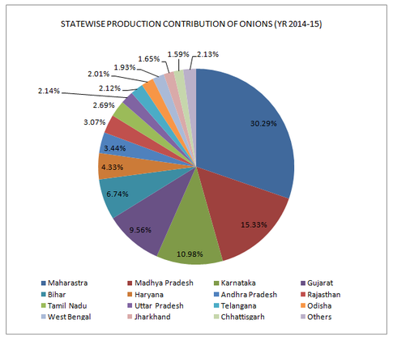
Major Producers
State wise Production Statistics

Slide 7
Distribution of Produce
FYI: India is the second largest producer of onions in the world.
In 2014 approx 18.92 Million MT Onion was produced in India.
So, let’s see what happens to these huge produce.
Out of 100%, approximately
20% is lost.
15.85% is exported
64.15% is total supply to domestic market
Note: Approx 14.96% Rabi crop goes to temporary storage and then later released in July-August which becomes part of total supply.

Slide 8
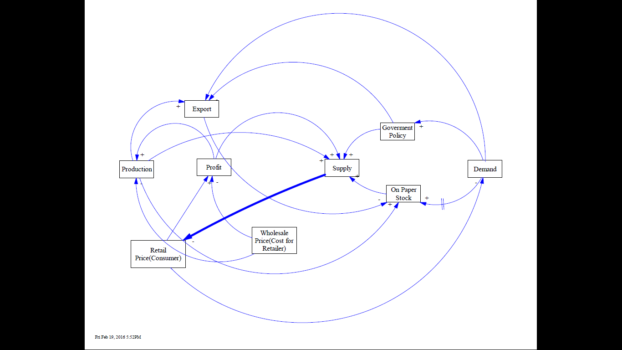
Market Model of Onion (Rabi)

Slide 9
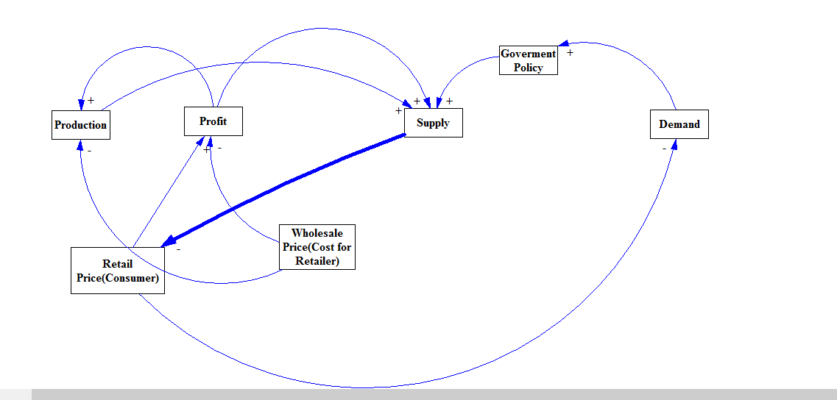
Market Model of Onion (Kharif)

Slide 10
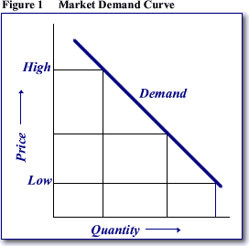

Law of demand
Keeping other factors constant, increase in price decreases the demand
In our words: $price ∝\frac{1}{demand}$
Increase in price = Less quantity demanded
Decrease in price = High quantity demanded

Slide 11
Demand Of Onion
From North to South and East to West, it is used in many ways:
It's pureed, sautéed and added to many vegetable, Dal or meat preparations.
Even used to garnish in meals, Eaten raw as a salad, Used as a dip, Fried as fritters and crisps.
One cannot substitute onion with any other vegetable, so demand for onions is completely inelastic.
Total annual consumption requirement of onion is 2012-13 is estimated at 12500 Kilo tones, growing at around 6 percent annually.
Additionally, there is also a lot of demand of Indian Onion in the world. Onion is mainly exported from India in the form of dehydrated onion, canned onion and onion pickle. Dehydrated onions are considered as a potential product in world trade and India is the second largest producer of dehydrated onions in the world.
Increasing high inelastic demand is a big factor yet it cannot be the only reason why market prices of onions is so volatile.

Slide 12
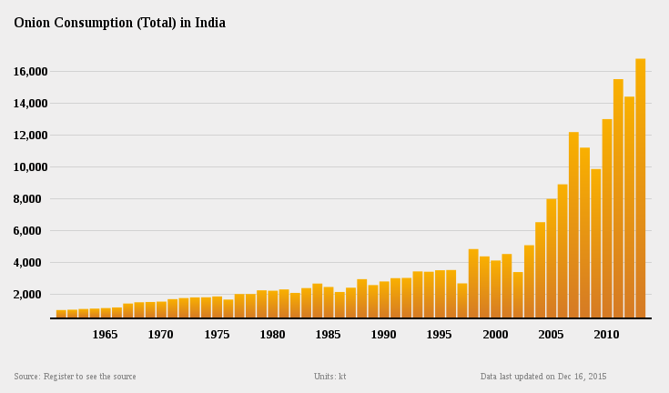
Statistics of consumption
There is a huge increase in the consumption of onion during the last decade
and the reason of increase is population and onions versatility.

Slide 13
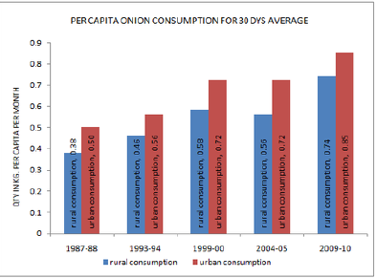
Between years 2004-05 and 2009-10, the consumption of onions increased 32% and 18% in rural and urban India
respectively while production of onions in India between these two years increased almost 90%. The reason for increase
in production was increase in export of onions due to easy foreign trade during this years and also other neighbour onion
producing countries decided to ban onion exports to meet their own demand.

Slide 14
“The demand for onions is completely inelastic. You cannot substitute it with any other vegetable.” -Ashok Gulati, Farm economist, Head of India's Commission for Agricultural Costs and Prices.
So, the Indians cannot live without onions. ☹

Slide 15
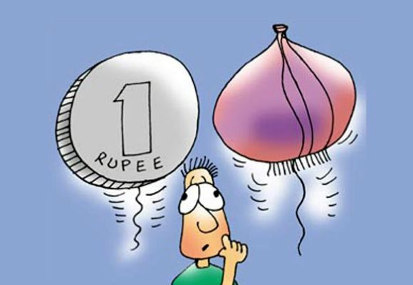
Why would this day never going to come?

Slide 16
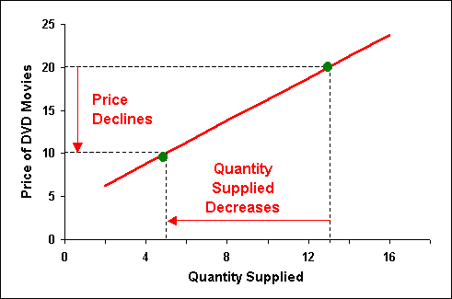
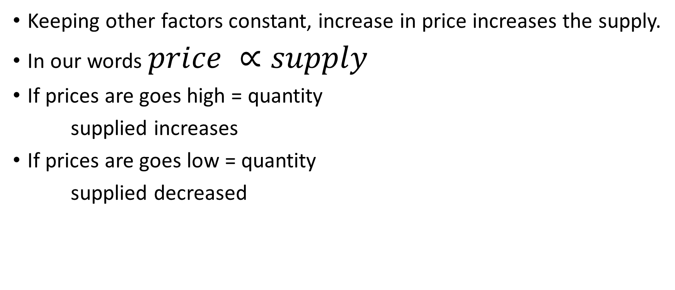
Law of supply
Keeping other factors constant, increase in price increases the supply.
In our words $price ∝supply$
If prices are goes high = quantity
supplied increases
If prices are goes low = quantity
supplied decreased

Slide 17
Case study of Supply

Slide 18
Market Trends of Onion
Let’s study and analyze price vs. arrival curves of onions in the year 2013 and 2014.

Slide 19
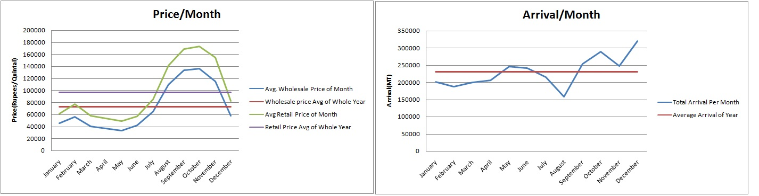
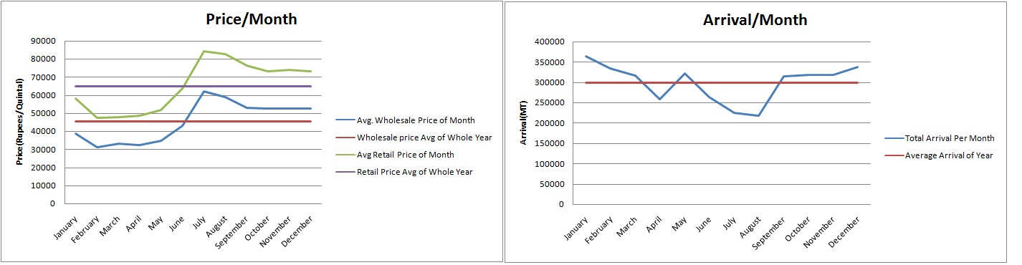
Contd.
Year 2013
Year 2014

Slide 20
Analysis of Graph
During Rabi Season we see that price remains very less affected.
Profit by traders increases significantly during high price rise period.
The bad supply is stabilized by good Kharif yield, government policies and forced order of getting all stocks out of storage and policies against hoarding.
Notice high price rise in 2013 and profit in 2013 as arrival decreased very much.
Good arrival in 2014 than 2013 made onion price low.
The fear of price rise increases hoarding in July-August(Slack Season/Highest amount of storage) resulting in lower supply of onion. But it is compensated by good kharif yield.
Notes:
Freeze the Projecter

Slide 21
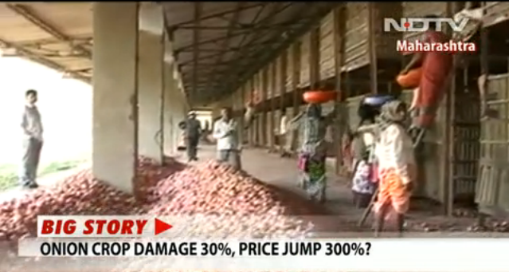
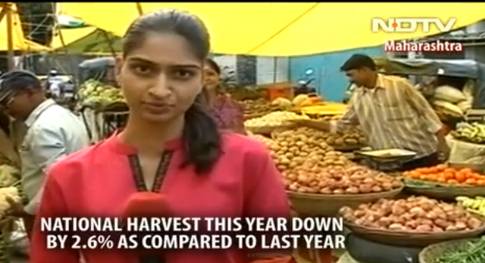
Onion price rise in news

Slide 22
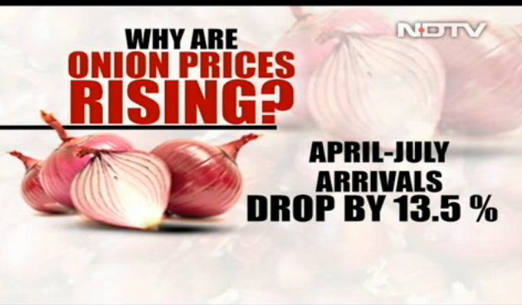
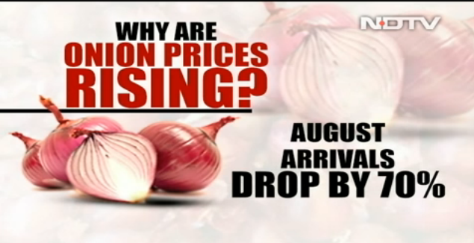
Contd.

Slide 23
Case study-Why do Onion Prices Rise?
We often see that there is price rise of onion generally during months of July-October.
Main factors are:-
-Poor Logistics or Late arrival
-Low Production during Kharif seasons due to natural factors
-Hoarding
-Crop loss in storage due to decay, damage etc..

Slide 24
Detailed Explanation
Onion prices follow a cyclic pattern, and show a tendency to rise from July to September. This is the lean period before the new harvest comes in.
Bad weather forecast lead the traders to stop/decrease supply
High prices in addition to fear of even higher prices leads consumers also to buy more than needed and hoard.

Slide 25
Case Study 2: Hoarding
The domination of traders and commission agents dealing with Onions is increased. They are squeezing money out of consumers and farmers both, by buying at cheap rate from farmers and selling at higher price to consumers. There is no direct contact of consumers and farmers. Big stock owners and traders often dominate primary sellers, discourage other buyers by determining higher prices during auction and trade.
These big stock owners and traders are buying onions and holding them in cold storage thus decreasing supply in main stream market, while the demand is constant or rising. This is because prices are rising like temperature in Saharan Desert.

Slide 26
Government measures to contain price rise of onion
A decision has been taken by the Government to import Onions and a tender has also been floated for 10,000 MT of Onions which was opened on 27th August, 2015.
To increase the availability of Onions in domestic market, it has been decided to raise Minimum Export Price(MEP) of Onions further to US$ 700 per MT
MEP was last increased from US$ 250 per MT to US$ 425 per MT. on 26th June, 2015

Slide 27
Elasticity

Slide 28
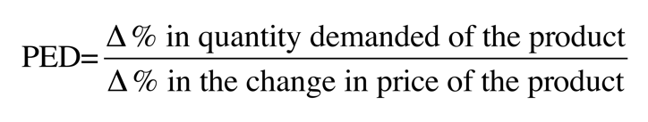
Demand Elasticity
Elastic – When a small change in price = large change in quantity demanded
Inelastic – When change in price causes only small change in quantity demanded

Slide 29
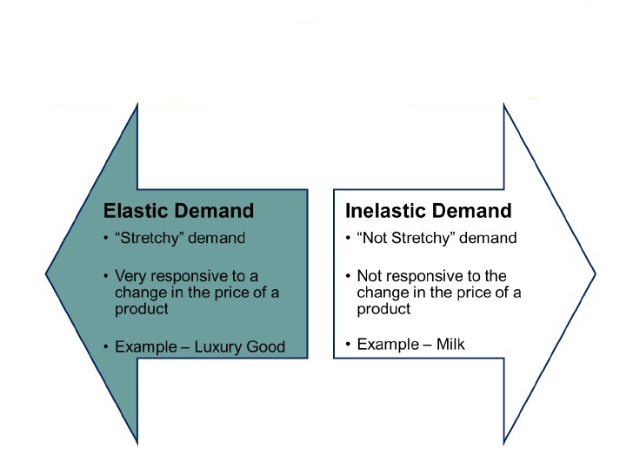
Contd.

Slide 30
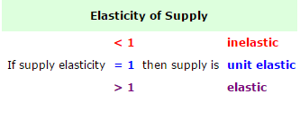
Supply Elasticity
Supply elasticity measures the relationship between change in quantity supplied following a change in price
The formula for price elasticity of supply is:
Percentage change in quantity supplied divided by the percentage change in price
If supply elasticity = infinity then supply is perfectly elastic

Slide 31
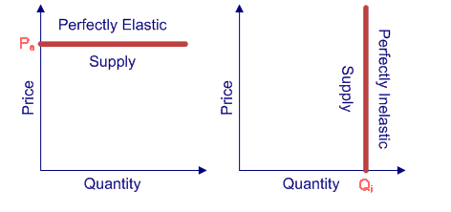
An increase in demand can be met without any change in price
Supply is fixed and cannot respond to a change in demand.

Slide 32
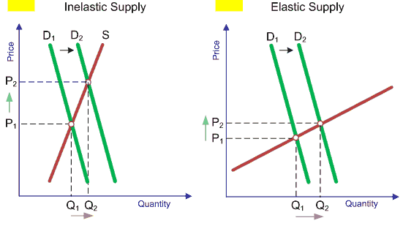
When demand changes from D₁ to D₂, the percentage change in price is greater than the percentage change in quantity provided.
When supply is elastic, then the percentage change in quantity is greater than the percentage change in price.

Slide 33
Factors affecting Supply Elasticity
Time
Availability of resources
Number of producers
Ease of storing stocks
Increase in cost of production as compared to output
Improvement in Technology
Stock of finished goods

Slide 34
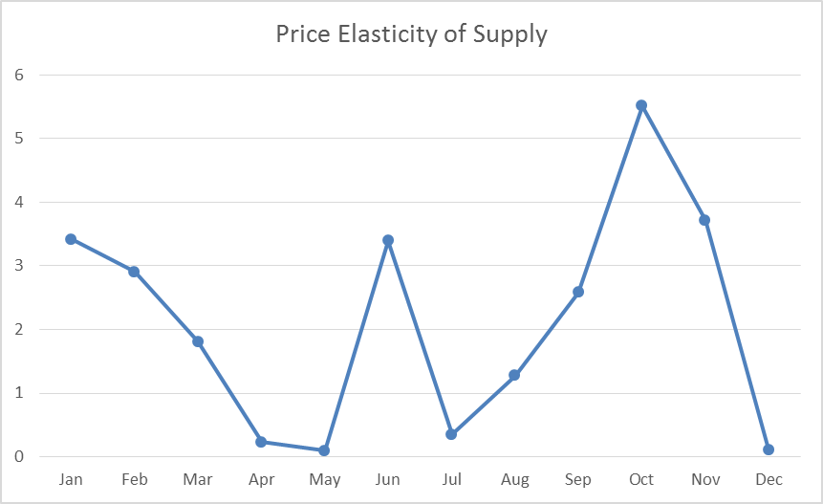
Price elasticity of supply(E) = %change in quantity supplied /
% change in price

Slide 35
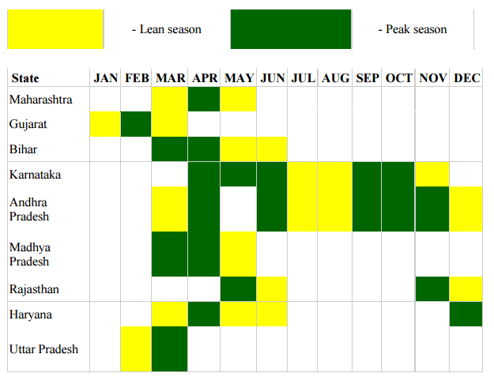
Explanation of above Graph
The peaks in the preceding graph between the months of September-October and May - June , is because of arriving of new onion harvest in market .
Therefore total stock ( i.e. new arrival + old stocks) increases, hence the price of onion decreases.
Source: APEDA Exchange

Slide 36
Cont.
Price elasticity also depends on supply chain between producer and consumer .
Variance in supply and price also depends on the length of supply chain .

Slide 37
Relation : L(supply chain) α 1/supply Elasticity
Producer
Wholesaler
Retailer
Local Trader
Consumer
producer
Wholesaler
Retailer
Consumer
Producer
Consumer
Producer
Retailer
Consumer

Slide 38
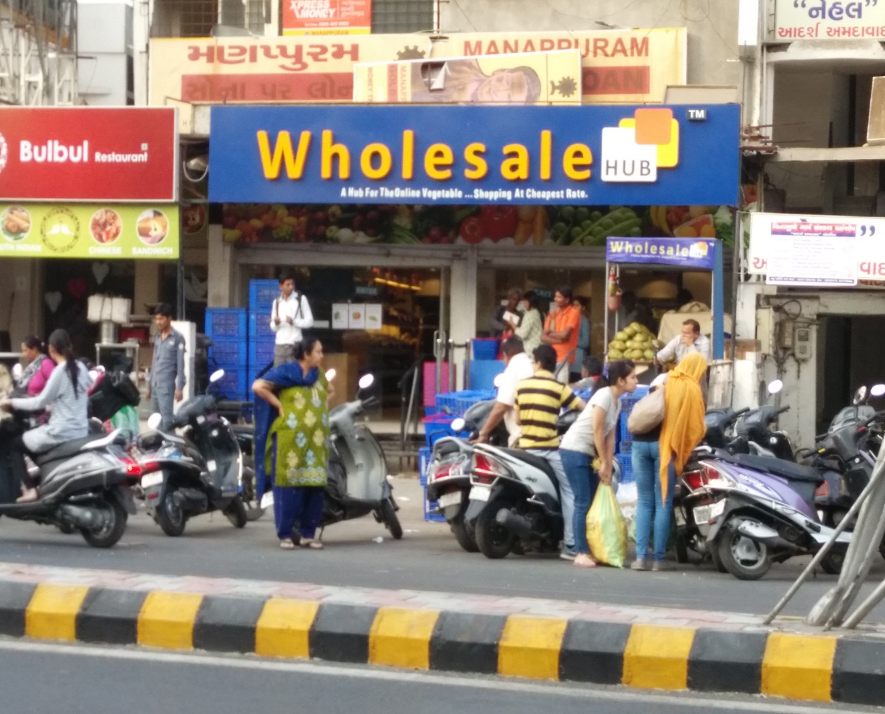
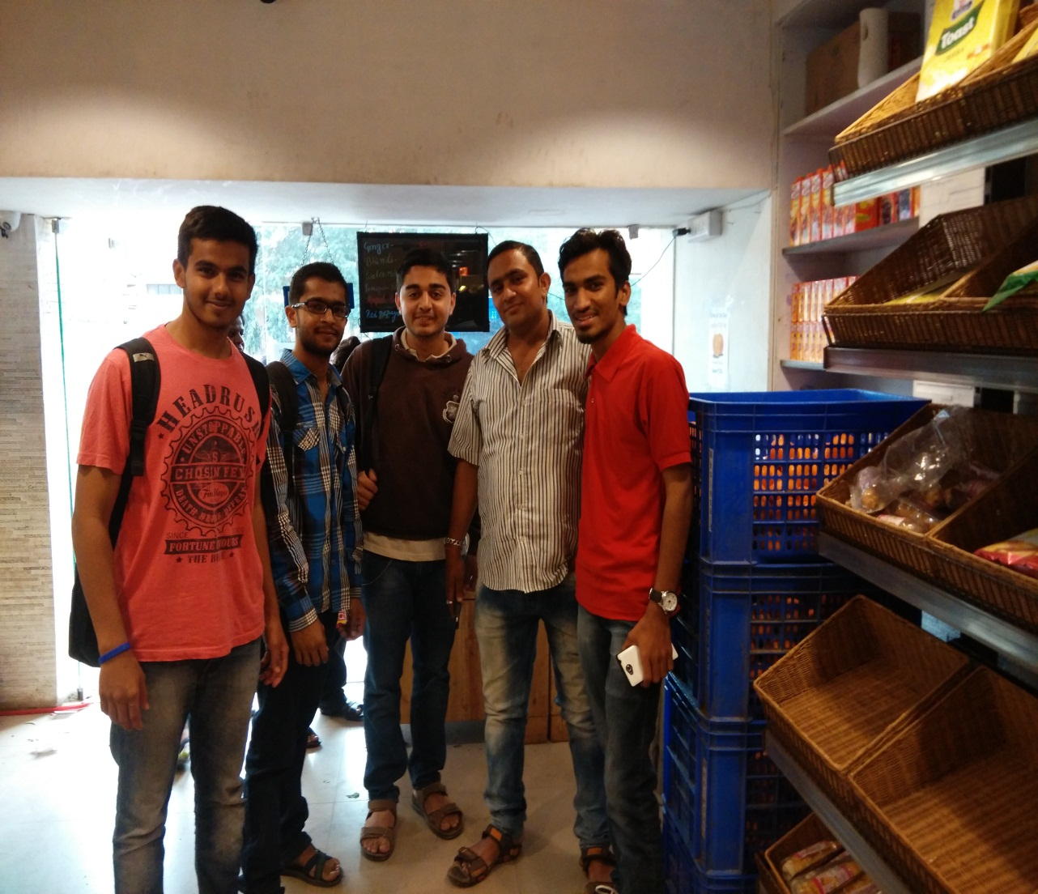
Field work

Slide 39
References
http://nhb.gov.in/default.aspx
Department of Horticulture, Government of Gujarat
http://sfacindia.com/
http://nhm.nic.in/

Slide 40
Special Thanks to….
Mr. Chittranjan M. Patel (Joint Director, Department of Horticulture, Government of Gujarat).
Guided By,
Rita Sharma
Anmol Anubhai

